Slide 1
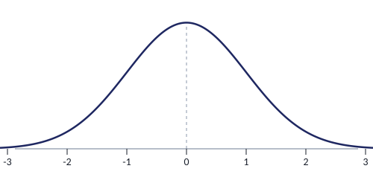
Normal Distributions &
the Central Limit Theorem
MA235 | Statistics
Chapters 6 & 7 • Brase & Brase
Notes:
Welcome slide. This deck covers three connected topics over two weeks: the standard normal distribution, nonstandard normal distributions (which the homework focuses on), and the Central Limit Theorem. Remind students these concepts build on each other — you need z-scores before you can convert x to z, and you need both before CLT makes sense.

Slide 2



Roadmap: Where We're Headed
Part 1
Week 1, Day 1
The Standard Normal Distribution
Z-scores, reading the table, finding areas under the curve
Part 2
Week 1–2
Nonstandard Normal Distributions
Converting x to z, inverse normal, applied problems
Part 3
Week 2
The Central Limit Theorem
Sampling distributions, standard error, sample means
Notes:
Give students the big picture before diving in. Emphasize that Part 2 (nonstandard normal) is the heaviest section and directly connected to their homework. The CLT builds on everything before it. Each part feeds into the next.

Slide 3
THE ORIGIN STORY
Where Did This Curve Come From?
1800s — Astronomers
When astronomers measured the same star's position many times, the errors clustered in a bell shape — small errors were common, large errors were rare. Gauss described this pattern mathematically.
1835 — Adolphe Quetelet's Big Idea
A Belgian astronomer named Quetelet asked: what if this pattern isn't just about measurement errors? What if it shows up in people? He obtained chest measurements of over 5,000 Scottish soldiers, plotted them, and saw the same bell shape. He repeated it with heights. Same curve.
The Discovery
He called the center value "l'homme moyen" — the average man. Heights, birth weights, blood pressure, exam scores, manufacturing tolerances — the same bell-shaped curve appeared over and over.
Nobody designed the normal distribution to fit human data. Someone just measured a bunch of people, plotted the results, and this shape kept showing up on its own.
Notes:
OPENING HOOK: Start class with this question: 'Imagine you measured the height of every person in this building and made a histogram. What shape would it be?' Let students answer. Then reveal that a Belgian astronomer asked the same question almost 200 years ago and accidentally discovered one of the most important patterns in all of statistics. The Quetelet story is powerful because it shows this isn't abstract math — someone literally measured thousands of soldiers and the bell curve appeared naturally. The normal distribution wasn't invented, it was DISCOVERED in real data. Fun fact: Quetelet was actually trained as an astronomer. He applied the same error-analysis tools from astronomy to human populations. This cross-disciplinary thinking is what made the breakthrough possible. Transition to next slide: 'So what exactly ARE the properties of this curve that kept showing up?'

Slide 4


PART 1: STANDARD NORMAL
What Is a Normal Distribution?
Bell-shaped and symmetric about the mean (μ)
Mean = Median = Mode (all at the center)
Total area under the curve equals 1
Described entirely by two parameters: μ and σ
Tails extend infinitely but never touch the x-axis
Why it matters:
Many natural phenomena (heights, test scores, measurement errors) follow a normal distribution. This lets us calculate probabilities for real-world events.
Notes:
Start by asking students: 'What shapes have you seen data take?' Most will mention bell curves from prior classes. Key teaching points: (1) the normal distribution is a MODEL — real data is approximately normal, (2) the two parameters μ and σ completely determine the shape, (3) the area = probability connection is the foundation for everything that follows. Common misconception: students think all data is normal. Emphasize this is a specific distribution with specific properties.

Slide 5
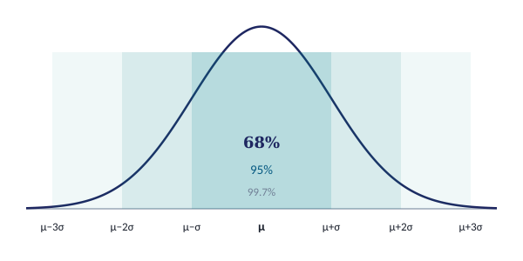
PART 1: STANDARD NORMAL
The Empirical Rule (68–95–99.7)
68%
of data falls
within 1σ of μ
95%
of data falls
within 2σ of μ
99.7%
of data falls
within 3σ of μ
Example: If exam scores have μ = 75 and σ = 8, then about 68% of students score between 67 and 83, about 95% score between 59 and 91, and nearly all (99.7%) score between 51 and 99.
Notes:
The empirical rule is a quick estimation tool — students should memorize 68-95-99.7. Walk through the exam example: μ = 75, σ = 8, so 1σ = 67 to 83. Ask: 'If you scored 90, how unusual is that?' (Beyond 2σ above, so in the top ~2.5%). This builds intuition before we get precise with the z-table. Common misconception: students confuse 'within 2σ' with 'exactly at 2σ'.

Slide 6
PART 1: STANDARD NORMAL
The Standard Normal (Z) Distribution
Definition
The standard normal distribution is a special normal distribution where:
μ = 0 (mean is zero)
σ = 1 (std dev is one)
What is a z-score?
A z-score tells you how many standard deviations a value is from the mean. A z-score of 1.5 means the value is 1.5 standard deviations above the mean. A z-score of −2.0 means 2 standard deviations below the mean.
We use the standard normal as a reference — Table 5 gives us areas (probabilities) for any z-score. Every other normal distribution can be converted to this one.
Notes:
Emphasize: the standard normal is 'the one table to rule them all.' Students often ask 'why do we need z-scores?' The answer is that we'd need infinite tables for every possible μ and σ combination. Instead, we convert everything to z and use one table. Ask students: 'If z = 0, where are you on the curve?' (At the center/mean). 'If z = −1?' (One standard deviation below the mean).

Slide 7

PART 1: STANDARD NORMAL
Formula: The Z-Score
z = (x − μ) / σ
z
= the z-score (number of standard deviations from the mean)
x
= the raw data value you're interested in
μ
= the population mean
σ
= the population standard deviation
Quick example: If x = 85, μ = 75, σ = 8 → z = (85 − 75) / 8 = 10/8 = 1.25
Notes:
Walk through the formula slowly. Common errors: (1) students subtract in the wrong order (μ − x instead of x − μ), (2) they forget to divide by σ, (3) they mix up σ and σ². The quick example shows x = 85 on an exam with μ = 75, σ = 8. So this student scored 1.25 standard deviations above average. Ask: 'Is that good? How good?' — leads into the next slide about reading the table.

Slide 8
PART 1: STANDARD NORMAL
How to Read the Z-Table (Table 5)
1
Split your z-score: the ones and tenths digit give you the ROW
(e.g., z = 1.25 → row 1.2)
2
The hundredths digit gives you the COLUMN
(e.g., z = 1.25 → column .05)
3
The value where the row and column meet is the AREA to the LEFT of z
This area = P(z < 1.25) = 0.8944
Remember: Table 5 always gives cumulative area from the LEFT
This means the table value is P(z < your value). If you need P(z > a), you'll subtract from 1. If you need P(a < z < b), you'll subtract two table values. We'll cover these cases next.
Notes:
This is a critical mechanical skill — spend time here. Have students open their tables and practice looking up values together. Common mistakes: (1) reading the wrong row (confusing 1.2 and 2.1), (2) forgetting that the table gives LEFT-tail area, (3) not knowing what to do when they need right-tail. Tip: have students highlight the z = 0 row (area = 0.5000) as an anchor point.

Slide 9
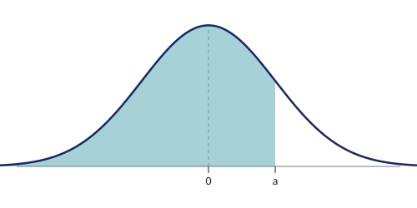
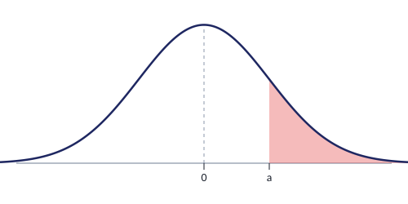
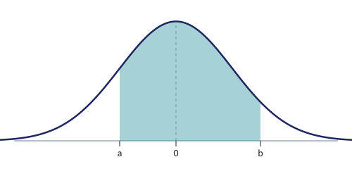
PART 1: STANDARD NORMAL
Finding Areas: Three Cases
Case 1: P(z < a)
Case 2: P(z > a)
Case 3: P(a < z < b)
Read directly from table
= 1 − P(z < a)
= P(z < b) − P(z < a)
Tip: Sketch the curve and shade the area FIRST — then decide which case you're in.
Notes:
This slide is a reference students will come back to repeatedly. Walk through each case with a concrete z-value. For Case 2, emphasize the complement rule: 'the total area is 1, so the right side is 1 minus the left side.' For Case 3: 'think of it as the big area minus the small area.' The tip about sketching first is critical — drawing the curve prevents most errors. Have students practice identifying which case before computing.

Slide 10
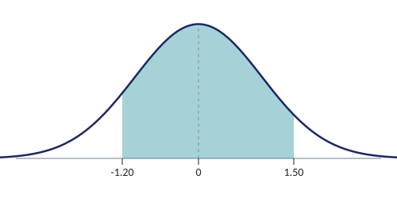
PART 1: STANDARD NORMAL
Worked Example: P(−1.20 < z < 1.50)
1
Identify the case: we need the area BETWEEN two z-values → Case 3
2
Look up P(z < 1.50) in Table 5
Row 1.5, Column .00 → 0.9332
3
Look up P(z < −1.20) in Table 5
Row −1.2, Column .00 → 0.1151
Shaded area =
P(−1.20 < z < 1.50)
4
Subtract: 0.9332 − 0.1151 = 0.8181
Result: P(−1.20 < z < 1.50) = 0.8181
Interpretation: There is an 81.81% probability that a randomly selected z-value falls between −1.20 and 1.50.
Notes:
Walk through each step slowly with students following along in their own tables. After completing this, ask: 'What would change if I asked for P(z > 1.50)?' (Case 2: 1 − 0.9332 = 0.0668). 'What about P(z < −1.20)?' (Already found it: 0.1151, that's Case 1 with a negative z). This reinforces all three cases in one discussion.

Slide 11
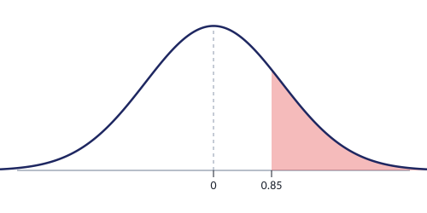

PART 1: STANDARD NORMAL
Worked Example: P(z > 0.85)
1
Identify the case: area to the RIGHT of z → Case 2
2
Look up P(z < 0.85) in Table 5
Row 0.8, Column .05 → 0.8023
3
Apply complement: P(z > 0.85) = 1 − 0.8023 = 0.1977
Shaded area = P(z > 0.85)
Result: P(z > 0.85) = 0.1977
Interpretation: About 19.77% of the standard normal distribution lies above z = 0.85.
Common Mistake:
Students often read 0.8023 from the table and report it as the answer. But the table gives left-tail area. For right-tail, you MUST subtract from 1.
Notes:
This is the most common error on exams — reading the table value and forgetting to subtract from 1 for right-tail problems. Drill this: 'Table gives LEFT. If you want RIGHT, subtract from 1.' Have students say it aloud. Also note: if z is negative and you want P(z > negative value), you still use 1 − table value, but the answer will be greater than 0.5 (which makes sense — you're asking for the area to the right of a point left of center).

Slide 12
PART 1: STANDARD NORMAL
Practice: Standard Normal Problems
1
Find P(z < 2.33)
Case 1 — read directly
2
Find P(z > −0.55)
Case 2 — complement
3
Find P(0.40 < z < 2.10)
Case 3 — subtract two areas
4
Find P(−1.96 < z < 1.96)
Case 3 — what percent is this?
Try these with your table — answers in the speaker notes!
Notes:
ANSWERS: 1. P(z < 2.33) = 0.9901 (read directly from table) 2. P(z > −0.55) = 1 − P(z < −0.55) = 1 − 0.2912 = 0.7088 3. P(0.40 < z < 2.10) = P(z < 2.10) − P(z < 0.40) = 0.9821 − 0.6554 = 0.3267 4. P(−1.96 < z < 1.96) = P(z < 1.96) − P(z < −1.96) = 0.9750 − 0.0250 = 0.9500 Note on #4: This is the famous 95% confidence interval boundary! Students will see ±1.96 again when they get to confidence intervals. Worth mentioning: 'Remember this number — you'll see it a LOT.'

Slide 13

PART 2: NONSTANDARD NORMAL
Why We Convert: From x to z
Original Distribution
Standard Normal
x ~ Normal(μ, σ)
Any mean, any std dev
No table available!
z ~ Normal(0, 1)
Mean = 0, Std dev = 1
Table 5 works!
μ = ?, σ = ?
μ = 0, σ = 1
z = (x − μ) / σ
This single formula lets us convert ANY normal distribution problem into a standard normal problem that we can solve with Table 5.
Notes:
This is the bridge slide — make sure students understand WHY we convert before drilling HOW. The key insight: we only have ONE table (Table 5, for the standard normal). If exam scores have μ = 75, σ = 8, there's no 'Table for Normal(75, 8).' We need to translate to the universal z-scale. Analogy: it's like converting currencies — whether you start with euros, yen, or pounds, you convert to one common currency (z) to compare.

Slide 14
PART 2: NONSTANDARD NORMAL
Formula: Converting x to z
z = (x − μ) / σ
Procedure for finding P(a ≤ x ≤ b):
1
Sketch the normal curve, mark μ, and shade the region of interest
2
Convert each x boundary to z: z = (x − μ) / σ
3
Use Table 5 to find the area (apply the correct case: left, right, or between)
4
Interpret the result as a probability or percentage
Notes:
This procedure should become automatic for students. Emphasize step 1 — sketching the curve prevents most errors. Students who skip the sketch make more sign errors and case-identification errors. Have them practice: 'I will ALWAYS draw the curve first.' Also remind them: probabilities are always between 0 and 1. If they get a negative probability or something greater than 1, they made an error.

Slide 15
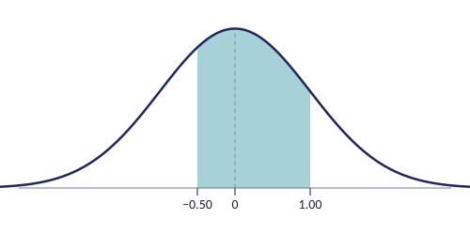
PART 2: NONSTANDARD NORMAL
Worked Example: Finding P(3 ≤ x ≤ 6)
Problem (HW #5 format):
x has a normal distribution with μ = 4 and σ = 2. Find P(3 ≤ x ≤ 6).
1
Convert x = 3: z₁ = (3 − 4) / 2 = −0.50
2
Convert x = 6: z₂ = (6 − 4) / 2 = 1.00
3
Table lookup: P(z < 1.00) = 0.8413
P(z < −0.50) = 0.3085
z-scale
4
Subtract: 0.8413 − 0.3085 = 0.5328
P(3 ≤ x ≤ 6) = 0.5328
About 53.28% of x-values fall between 3 and 6.
Notes:
This matches HW problem #5 exactly: P(3 ≤ x ≤ 6); μ = 4; σ = 2. Walk through each step deliberately. Point out that we converted a 'nonstandard' problem into the standard z-table problem from Part 1. The mechanics are the same — we just added the conversion step at the beginning. Ask students: 'Does 53% make sense? Where is the interval relative to the mean?' (It's from 0.5σ below to 1σ above — slightly more than half the curve, which checks out.)

Slide 16
PART 2: NONSTANDARD NORMAL
Worked Example: Left and Right Tail
Weights are normally distributed: μ = 172 lb, σ = 29 lb
Find P(x < 150)
Find P(x > 200)
z = (150 − 172) / 29 = −0.76
Table: P(z < −0.76) = 0.2236
P(x < 150) = 0.2236
z = (200 − 172) / 29 = 0.97
Table: P(z < 0.97) = 0.8340
P(x > 200) = 1 − 0.8340 = 0.1660
Pattern: Convert x to z first, then apply the same three cases from Part 1. Left tail = read table directly. Right tail = subtract from 1.
Notes:
Side-by-side comparison helps students see the pattern. Left: straightforward table lookup (Case 1). Right: complement (Case 2). The only new step is the z-conversion at the beginning. Ask: 'Which is more likely — weighing less than 150 or more than 200?' (Less than 150 at 22.36% vs more than 200 at 16.60%). This builds intuition about where values fall relative to the mean.

Slide 17
PART 2: NONSTANDARD NORMAL
Applied: Police Response Time
Problem (matches HW #28):
Police response time is normally distributed with μ = 8.4 min and σ = 1.7 min.
(a) P(5 < x < 10)
(b) P(x < 5)
(c) P(x > 10)
z₁ = (5−8.4)/1.7 = −2.00
z₂ = (10−8.4)/1.7 = 0.94
= 0.8264 − 0.0228
= 0.8036
z = −2.00
P(z < −2.00)
= 0.0228
z = 0.94
1 − P(z < 0.94)
= 1 − 0.8264
= 0.1736
Interpretations:
(a) About 80.36% of response times fall between 5 and 10 minutes
(b) Only 2.28% of calls get a response in under 5 minutes
(c) About 17.36% of calls take more than 10 minutes
Notes:
This mirrors HW #28 exactly. Walk through part (a) fully, then let students try (b) and (c) before revealing. Key discussion point: 'What do these probabilities tell us about police response?' About 80% of the time, response is 5–10 min. Very rarely under 5 min (2.28%). About 1 in 6 calls takes over 10 min. Ask: 'If you were the police chief, what would concern you about these numbers?'

Slide 18
PART 2: NONSTANDARD NORMAL
Inverse Normal: The Reverse Problem
Forward Problem
Inverse Problem
Given: x value
Find: probability (area)
Given: probability (area)
Find: x value
"What is the probability that
response time is under 5 min?"
"How long should the guarantee
be to cover 93% of products?"
When do we use inverse normal?
Guarantee/warranty problems — "How long should we guarantee?"
Percentile problems — "What score is the 90th percentile?"
Cutoff problems — "What value separates the top 5%?"
Notes:
The inverse problem reverses the direction. Instead of 'given x, find probability,' it's 'given probability, find x.' Students often struggle with this conceptual flip. Use the analogy: forward = 'I know the score, what percentile am I?' Inverse = 'I want to be in the 90th percentile, what score do I need?' This is a very practical skill — companies use it for warranties, schools use it for grade cutoffs.

Slide 19
PART 2: NONSTANDARD NORMAL
Formula: From Probability to x
1
Start with the given probability (area). Sketch the curve and shade the region.
2
Convert to a LEFT-tail area if needed.
If given right-tail area, subtract from 1 first.
3
Look up the area in the BODY of Table 5 (not the margins).
Find the closest value. Read the z-score from the row and column.
x = z · σ + μ
Step 4: Plug in z, σ, and μ to find x
Remember: if the area is in the LEFT tail (below the mean), z will be NEGATIVE. Don't drop the sign!
Notes:
This is the inverse formula — just the z-score formula solved for x. Students sometimes try to use z = (x − μ)/σ directly for inverse problems and get confused. Emphasize: 'The table is used BACKWARDS — instead of looking up z to find area, you look up area to find z.' Key pitfall: students find the right z but use the wrong sign. If the area is less than 0.5, z must be negative.

Slide 20
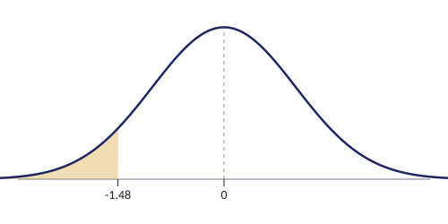
PART 2: NONSTANDARD NORMAL
Worked Example: Guarantee Problem
A video game system has a mean life of 30 months (σ = 4 months), normally distributed. The company will refund the full price if it fails during the guarantee period. How long should the guarantee be if they want no more than 7% refunded?
1
We want 7% in the LEFT tail (products that fail before the guarantee ends)
2
Look up area 0.0700 in body of Table 5
Closest: 0.0694 → z = −1.48
3
Convert to x: x = z·σ + μ
x = (−1.48)(4) + 30 = −5.92 + 30 = 24.08
7% in left tail
Answer: Guarantee for 24 months.
The company rounds down to 24 months. With this guarantee, they expect to refund no more than 7% of purchases.
Notes:
Classic inverse normal problem from the Brase textbook. Key teaching points: (1) 'No more than 7% refunded' means 7% in the left tail — these are the ones that fail early. (2) We round DOWN to 24 months, not up, because rounding up would mean MORE than 7% fail. (3) Ask students: 'What if the company wanted only 5% refunds? Would the guarantee be shorter or longer?' (Shorter — they'd need to cut off more of the left tail, meaning z is more negative, x is smaller).

Slide 21
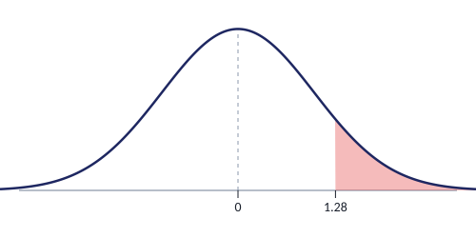
PART 2: NONSTANDARD NORMAL
Worked Example: Top Percentile Cutoff
Exam scores are normally distributed with μ = 72 and σ = 10. What score separates the top 10% from the rest?
1
Top 10% means 90% is to the LEFT
Left-tail area = 1 − 0.10 = 0.90
2
Look up area 0.9000 in body of Table 5
Closest: 0.8997 → z = 1.28
3
Convert: x = (1.28)(10) + 72 = 84.8
Round to 85
Top 10%
A score of 85 separates the top 10%.
Students scoring 85 or above are in the 90th percentile or higher.
Notes:
This is the 'right tail' version of inverse normal. Key step: convert 'top 10%' to a left-tail area first (0.90). Common mistake: students look up 0.10 instead of 0.90 and get a negative z-score, which would give a score BELOW the mean — clearly wrong for the top 10%. Tip: always sanity-check. Top 10% should be ABOVE the mean, so x > μ and z should be positive.

Slide 22
PART 2: NONSTANDARD NORMAL
Practice: Nonstandard Normal Problems
1
P(10 ≤ x ≤ 26); μ = 15, σ = 4
Convert both endpoints → Case 3
2
P(50 ≤ x ≤ 70); μ = 40, σ = 15
Both z-values will be positive
3
P(7 ≤ x ≤ 9); μ = 5, σ = 1.2
Convert → Table → Subtract
4
Response time μ = 8.4, σ = 1.7.
Find P(x < 5), P(5 < x < 10), P(x > 10)
Three parts — all three cases!
5
Battery life: μ = 500 hrs, σ = 40 hrs.
Guarantee so only 8% are returned. Find x.
Inverse — look up 0.08 in table body
Notes:
ANSWERS: 1. z₁=(10−15)/4=−1.25, z₂=(26−15)/4=2.75. P=P(z<2.75)−P(z<−1.25)=0.9970−0.1056=0.8914 2. z₁=(50−40)/15=0.67, z₂=(70−40)/15=2.00. P=0.9772−0.7486=0.2286 3. z₁=(7−5)/1.2=1.67, z₂=(9−5)/1.2=3.33. P=0.9996−0.9525=0.0471 4. This IS HW #28! z=(5−8.4)/1.7=−2.00, z=(10−8.4)/1.7=0.94. P(x<5)=0.0228, P(5<x<10)=0.8264−0.0228=0.8036, P(x>10)=1−0.8264=0.1736 5. Look up 0.0800 → closest 0.0793 → z=−1.41. x=(−1.41)(40)+500=443.6 → guarantee 443 hours Problems 1-3 match HW #5-8 format. Problem 4 matches HW #28. Problem 5 is an inverse problem.

Slide 23
PART 3: CENTRAL LIMIT THEOREM
From Individuals to Samples
A thought experiment:
1. Pick one random person and weigh them. Record it.
2. Now pick 30 random people. Compute their mean weight. Record it.
3. Repeat step 2 many times. Plot all those sample means.
What does the distribution of sample means look like?
Individual Values
Sample Means
Wide spread
High variability
Any one person can be
far from the mean
Narrow spread
Low variability
Averages tend to cluster
near the population mean
Uses σ
Uses σ / √n
Notes:
This is the conceptual foundation for CLT. Before stating the theorem, build intuition. Ask students: 'If I weigh one random person, might they weigh 250 lbs?' (Sure.) 'If I average 30 people, will the average be 250?' (Very unlikely.) That's the key insight — averages are more predictable than individuals. The distribution of sample means is NARROWER than the distribution of individuals. This is why we use σ/√n instead of σ.

Slide 24
PART 3: CENTRAL LIMIT THEOREM
What Is a Sampling Distribution?
Definition
The sampling distribution of the mean (x̄) is the probability distribution of all possible sample means when all samples of the same size n are taken from the same population.
Population
Take many
samples of
size n
Compute x̄
for each
sample
→
→
μ, σ known
Key properties of the sampling distribution:
• The mean of all sample means equals the population mean: μ_x̄ = μ
• The spread is smaller: σ_x̄ = σ / √n (called the standard error)
• The shape approaches normal as n increases
Notes:
Sampling distributions are a conceptual leap for students. Emphasize: we're not talking about one sample — we're imagining ALL possible samples of size n. Each gives a mean. Plot all those means. That distribution has predictable properties. The standard error σ/√n gets smaller as n increases, meaning larger samples give more precise estimates. This is WHY bigger samples are better.

Slide 25
PART 3: CENTRAL LIMIT THEOREM
The Central Limit Theorem
Central Limit Theorem
If random samples of size n are drawn from ANY population with mean μ and standard deviation σ, then as n increases, the distribution of sample means x̄ approaches a normal distribution with:
μ_x̄ = μ
σ_x̄ = σ / √n
In plain English:
1. The average of averages equals the population average (no bias)
2. Sample means are less spread out than individual values (by a factor of √n)
3. The shape is approximately normal — even if the original population is NOT normal
Notes:
This is the big theorem of the course. Point #3 is the remarkable part — it doesn't matter if the population is skewed, uniform, bimodal, or any other shape. As long as n is large enough, x̄ will be approximately normal. This is why the normal distribution is so central to statistics. Ask: 'Why is this so powerful?' Because it means we can use normal probability methods for sample means from ANY population.

Slide 26
PART 3: CENTRAL LIMIT THEOREM
Key Formulas: Standard Error
σ_x̄ = σ / √n
This is called the Standard Error of the Mean
How sample size affects the standard error:
Sample Size | Formula | σ_x̄ (if σ = 29) | Effect
n = 1 | σ / √1 = σ | 29 | Same as individual
n = 9 | σ / √9 = σ/3 | 9.67 | 1/3 the spread
n = 25 | σ / √25 = σ/5 | 5.80 | 1/5 the spread
n = 100 | σ / √100 = σ/10 | 2.90 | 1/10 the spread
Notes:
Using σ = 29 (men's weights from earlier examples) makes this concrete. Walk through: with n = 1, you get the full spread. With n = 100, the standard error is only 2.90 — sample means will cluster tightly around μ. This is why political polls use large samples. Key insight: the reduction follows a square root — to cut the error in HALF, you need to QUADRUPLE the sample size (not double it). This has practical implications for study design.

Slide 27
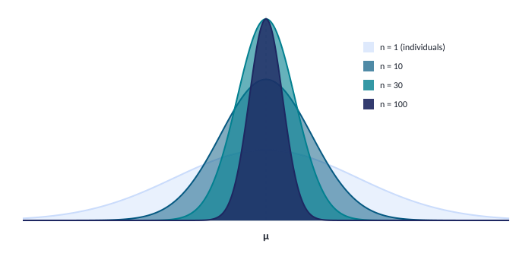
PART 3: CENTRAL LIMIT THEOREM
The CLT in Action
As n increases, the distribution of x̄ gets taller and narrower — sample means cluster more tightly around μ.
This is why larger samples give more precise estimates.
Notes:
This visual is the 'aha moment' for CLT. Point to the wide blue curve: 'That's what happens when we look at individuals — lots of spread.' Then the darker curves: 'As we average more people, the curve gets narrower and taller. With n = 100, almost all sample means cluster right near μ.' Key discussion: 'Could a single person weigh 250 lbs?' (Yes, the blue curve extends far.) 'Could the AVERAGE of 100 people be 250?' (Essentially impossible — the dark curve has almost no area that far out.) That's the CLT in action. Connect to the table from the previous slide: n = 1 has σ_x̄ = 29, n = 100 has σ_x̄ = 2.90. This picture IS those numbers.

Slide 28
PART 3: CENTRAL LIMIT THEOREM
When Does the CLT Apply?
Rule 1: n > 30
Rule 2: Any n
If the sample size is greater than 30, the sampling distribution of x̄ is approximately normal — regardless of the shape of the original population.
If the original population is already normally distributed, then the sampling distribution of x̄ is normal for ANY sample size n — even n = 2.
Works for skewed, uniform, bimodal — any shape!
Normal population → normal x̄ always
Quick Decision Guide:
Is the population normal? → Yes: Use CLT with any n
Is the population NOT normal (or unknown)? → Is n > 30? Yes: Use CLT
Population not normal AND n ≤ 30? → Cannot use CLT (need other methods)
Notes:
Students need to know WHEN they can use CLT on exams. The decision guide is key: (1) Check if population is normal → if yes, CLT works for any n. (2) If not normal or unknown → need n > 30. (3) If neither condition is met, CLT doesn't apply. Common exam question: 'Can you use CLT here?' where they give a small n from a non-normal population. Answer: No. Also note: 30 is a rule of thumb, not a magic number. The more skewed the population, the larger n needs to be.

Slide 29
PART 3: CENTRAL LIMIT THEOREM
Individual vs. Sample Mean: Key Difference
One Individual (x)
Sample Mean (x̄)
"If one man is randomly selected..."
z = (x − μ) / σ
Use the full standard deviation σ
Wider spread → higher probability of
extreme values
"If 20 men are randomly selected..."
z = (x̄ − μ) / (σ/√n)
Use the standard error σ/√n
Narrower spread → extreme averages
are rare
The ONLY difference is the denominator: σ for individuals, σ/√n for sample means. On exams, read carefully: is the question about ONE value or an AVERAGE of n values?
Notes:
This is the most common exam mistake with CLT — students use σ when they should use σ/√n, or vice versa. The trigger word is 'mean' or 'average.' If the problem says 'a sample of 20 has a mean weight,' use σ/√n. If it says 'one person is selected,' use σ. Read the problem out loud and identify: am I finding the probability for ONE thing or an AVERAGE? Post this distinction visually in class.

Slide 30
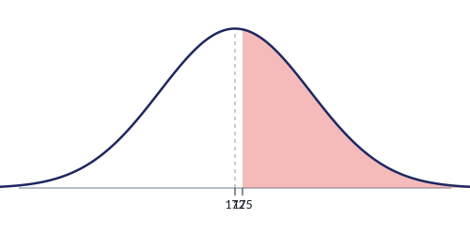
PART 3: CENTRAL LIMIT THEOREM
CLT Example: One Individual
Men's weights: μ = 172 lb, σ = 29 lb (normally distributed). If one man is randomly selected, find P(x > 175).
1
This is about ONE individual → use σ (not σ/√n)
2
z = (175 − 172) / 29 = 3/29 = 0.10
3
P(z > 0.10) = 1 − P(z < 0.10) = 1 − 0.5398 = 0.4602
P(x > 175) = 0.4602
About 46% of individual men weigh more than 175 lb. This is close to 50% because 175 is barely above the mean.
Notes:
This is the 'before CLT' part — solving for an individual uses the methods from Part 2 (nonstandard normal). Nothing new here except setting up the comparison for the next slide. Point out: z = 0.10 is tiny, meaning 175 is barely above the mean. So we'd expect close to 50% to be above it — and indeed 46.02% is close to 50%. This is a good sanity check technique.

Slide 31
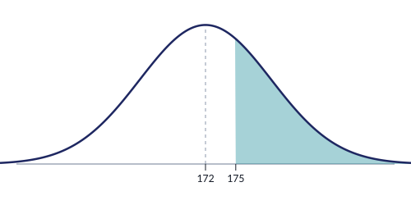
PART 3: CENTRAL LIMIT THEOREM
CLT Example: Sample of 20
Same population: μ = 172, σ = 29. Now 20 men are selected. Find P(x̄ > 175).
1
This is about a SAMPLE MEAN → use σ/√n
σ_x̄ = 29/√20 = 29/4.47 = 6.49
2
z = (175 − 172) / 6.49 = 3/6.49 = 0.46
3
P(z > 0.46) = 1 − P(z < 0.46) = 1 − 0.6772 = 0.3228
P(x̄ > 175) = 0.3228
Compare: Individual P(x > 175) = 0.4602 vs. Sample Mean P(x̄ > 175) = 0.3228
It's easier for one person to be above 175 than for a group's average to be above 175.
Notes:
This is the payoff — same numbers, different answer, because we use σ/√n. The z-score jumped from 0.10 to 0.46 even though the numerator (175 − 172 = 3) is the same. That's entirely because the denominator shrank from 29 to 6.49. Make the comparison explicit: 46% vs 32%. 'It's much harder for a GROUP average to be extreme than for one individual to be extreme.' This is the core insight of CLT. Water taxi context: with 20 men, there's about a 32% chance the boat is overloaded — that's pretty concerning for safety!

Slide 32
PART 3: CENTRAL LIMIT THEOREM
CLT Applied: Fill Volumes
A bottling machine fills soda cans with μ = 12.0 oz and σ = 0.5 oz. A quality inspector tests a random sample of 36 cans. What is the probability that the sample mean is less than 11.8 oz?
1
Identify: sample of n = 36 → use σ/√n
σ_x̄ = 0.5/√36 = 0.5/6 = 0.0833
2
z = (11.8 − 12.0) / 0.0833 = −0.2/0.0833 = −2.40
3
P(z < −2.40) = 0.0082
P(x̄ < 11.8) = 0.0082 (less than 1%)
Interpretation: If the machine is working correctly, there's less than 1% chance of getting a sample mean below 11.8 oz. If the inspector does get x̄ < 11.8, the machine is probably malfunctioning.
Notes:
This example connects CLT to hypothesis testing (which comes next in the course). The logic: if the machine is working (μ = 12), getting x̄ < 11.8 is VERY unlikely (0.82%). So if it DOES happen, we doubt the machine is working correctly. This is the foundation of hypothesis testing. Note: z = −2.40 is very far from zero — that's the power of large n. With n = 36, even a small difference (0.2 oz) from the mean is highly detectable.

Slide 33
PART 3: CENTRAL LIMIT THEOREM
Practice: Central Limit Theorem
Heights: μ = 64 in, σ = 3 in. One woman selected.
Find P(x > 66).
1
Individual → use σ
Same population. Sample of 25 women.
Find P(x̄ > 66).
2
Sample mean → use σ/√n
Package weights: μ = 50 lb, σ = 8 lb. Sample of 40.
Find P(x̄ < 48).
3
CLT applies (n > 30)
A non-normal population has μ = 100, σ = 15.
Can we use CLT with n = 10? With n = 50?
4
Check the rules!
Notes:
ANSWERS: 1. z = (66−64)/3 = 0.67. P(z > 0.67) = 1 − 0.7486 = 0.2514 (about 25%) 2. σ_x̄ = 3/√25 = 0.6. z = (66−64)/0.6 = 3.33. P(z > 3.33) = 1 − 0.9996 = 0.0004 (nearly impossible!) 3. σ_x̄ = 8/√40 = 1.265. z = (48−50)/1.265 = −1.58. P(z < −1.58) = 0.0571 (about 5.7%) 4. n = 10: NO — population is not normal and n ≤ 30. n = 50: YES — n > 30, so CLT applies regardless of population shape. Compare #1 and #2: same question, huge difference. Individual = 25%, sample mean = 0.04%. This dramatically shows the CLT effect.

Slide 34
HW CONNECTION
Review: Binomial Distribution (Ch. 6)
Your homework includes Chapter 6 review problems on binomial distributions. Here's a quick refresher.
Key Formulas
When Is a Result "Unusual"?
μ = np σ = √(npq)
A result is unusual if it falls outside:
μ − 2.5σ to μ + 2.5σ
where n = trials, p = P(success), q = 1 − p
If the observed value is outside this range,
it's considered unusual.
Example (HW #7 format):
Binomial: n = 10 trials, p = 0.2. Is more than 5 successes unusual?
μ = np = 10(0.2) = 2
σ = √(npq) = √(10 × 0.2 × 0.8) = √1.6 = 1.265
Upper boundary: μ + 2.5σ = 2 + 2.5(1.265) = 2 + 3.16 = 5.16
Since 5 < 5.16, five successes is NOT unusual. But more than 5 WOULD be unusual.
Notes:
This slide bridges to the Ch. 6 review problems on the HW. Students need to remember: - μ = np gives the expected number of successes - σ = √(npq) gives the spread - The 2.5σ rule determines if a result is unusual HW #3: Expected value of a probability distribution = the mean (answer: c) HW #7a: n=10, p=0.2. μ=2, σ=1.265. Upper bound = 5.16. So >5 successes is unusual (barely). HW #7b: n=10, p=0.2 (guessing on 5-choice questions). More than 5 correct? μ+2.5σ = 5.16, so yes, >5 is unusual. You'd be very unlikely to pass by guessing. HW #12: Binomial with n=20 pens. Use binomial formula or table. HW #13: n=16, p=0.5. μ=8, σ=2. For P(x≥12) and P(x≤7), use binomial tables or normal approximation.

Slide 35
SUMMARY
Key Formulas: Complete Reference
Z-Score (individual)
z = (x − μ) / σ
Finding probability for ONE value from the population
Inverse Normal
x = z · σ + μ
Finding the x-value that corresponds to a given probability
Standard Error
σ_x̄ = σ / √n
Working with sample means instead of individuals
Z-Score (sample mean)
z = (x̄ − μ) / (σ/√n)
Finding probability for a sample mean
Notes:
This is the cheat sheet slide — students will want to photograph this. Emphasize the decision process: (1) Am I working with one value or a sample mean? → Determines denominator. (2) Am I given x and finding probability, or given probability and finding x? → Determines direction (forward vs. inverse). All four formulas are variations of the same core idea: z = (value − mean) / standard deviation. The only question is WHICH mean and WHICH standard deviation.

Slide 36
DECISION GUIDE
Which Formula Do I Use?
What does the problem ask for?
↓
↓
Given x (or x̄) → Find probability
Given probability → Find x
Is it about ONE value or a SAMPLE MEAN?
Inverse Normal
↓
1. Convert to left-tail area
2. Look up area in body of Table 5 → find z
3. Solve: x = z · σ + μ
ONE value
SAMPLE MEAN
z = (x − μ) / σ
z = (x̄ − μ) / (σ/√n)
Guarantee problems, percentile
problems, cutoff problems
Use σ
Use σ/√n
Exam tip: Read the problem and circle the key words — "one person" → use σ, "sample of 30" → use σ/√n, "what value" → inverse
Notes:
Students should photograph this slide. Walk through the decision tree with examples: 'A man weighs more than 180 lb' → one value → z = (x−μ)/σ 'The average of 25 men exceeds 180 lb' → sample mean → z = (x̄−μ)/(σ/√n) 'What weight separates the top 5%?' → inverse → find z from table, solve x = zσ + μ Have students practice classifying problems before solving them. On exams, the #1 error is using the wrong formula — this flowchart prevents that. Suggest they draw a mini version of this tree on their scratch paper at the start of every exam.

Slide 37
SUMMARY
Common Mistakes to Avoid
Confusing z-scores and areas
Z-scores are positions on the x-axis. Areas are probabilities (regions under the curve). The table converts between them.
Forgetting to subtract from 1 for right-tail
Table gives LEFT-tail area. For P(z > a), always compute 1 − P(z < a).
Using σ instead of σ/√n for sample means
Read the problem: if it mentions a sample of n, use σ/√n as the denominator.
Dropping negative signs on z
If x < μ, then z MUST be negative. If your z is positive but x is below the mean, you made a sign error.
Reading the z-table wrong direction for inverse
Forward: find z in margins → read area in body. Inverse: find area in body → read z in margins.
Notes:
Go through each mistake and ask students if they've made it. Most will nod at #1 and #3. For #3 especially, suggest a highlighter trick: whenever they see 'sample of n' or 'mean of n,' they highlight it and write σ/√n in the margin immediately. This prevents the most common CLT error. For #4, suggest always checking: 'Is my x above or below μ? Then z should be positive/negative accordingly.'

Slide 38
SUMMARY
Sanity Checks: Catch Your Own Errors
If x > μ, then z must be positive
A value above the mean is always a positive z-score. If your z is negative but x > μ, you subtracted in the wrong order.
If x < μ, then z must be negative
Same logic in reverse. Below the mean = negative z. Always.
Probabilities are always between 0 and 1
If you get a negative probability or something greater than 1, you made an arithmetic or table-reading error.
Areas near the center ≈ 0.5, tails < 0.5
If a value is close to the mean, P(x < value) should be near 0.5. A value far from μ should give a very small or very large area.
Sample mean probabilities are more extreme
For the same cutoff, P(x̄ > value) should be further from 0.5 than P(x > value). If your CLT answer is LESS extreme, check your denominator — you may have used σ instead of σ/√n.
Notes:
These are 'gut check' rules students can apply AFTER solving a problem to verify their answer makes sense. Walk through each one with a concrete example: #1: If someone weighs 200 lbs and μ = 172, z should be positive (200 > 172). If you got z = −0.97, you did (172−200)/29 by mistake. #3: If you calculate P = −0.13 or P = 1.25, stop — that's impossible. #4: If x = 173 and μ = 172, the value is barely above the mean. P(x < 173) should be just over 0.5 (like 0.53). If you got 0.97, something's wrong. #5: This is the CLT check. In our earlier example, P(individual > 175) = 0.4602 and P(mean of 20 > 175) = 0.3228. The sample mean probability (0.32) is further from 0.5 than the individual (0.46). If those were reversed, you probably used the wrong denominator. Encourage students to make these checks a habit, especially on timed exams where rushing leads to errors.

Slide 39
What's Next?
These concepts are the foundation for:
Confidence Intervals — using sample means to estimate population parameters
Hypothesis Testing — deciding if sample evidence supports a claim
Both rely on normal distributions and the Central Limit Theorem
Make sure you're solid on z-scores, conversions, and σ/√n
before moving on!
Notes:
Wrap-up slide. Motivate students: everything they just learned feeds directly into the next two major topics. If they master z-scores and CLT now, confidence intervals and hypothesis testing will be MUCH easier. Encourage them to practice the homework problems and come to office hours if they're stuck on the conversion step. Remind them: the HW covers Section 7.3 (nonstandard normal) plus Chapter 6 review (binomial).

